Slide 1
Firearm Registration Correlated to State Crime and Social Statistics Data
Dream Team
Team Leader: Gene
Mike
Tulgaa
Enerel
GW_Data Analytics BootCamp
July, 2019

Slide 2
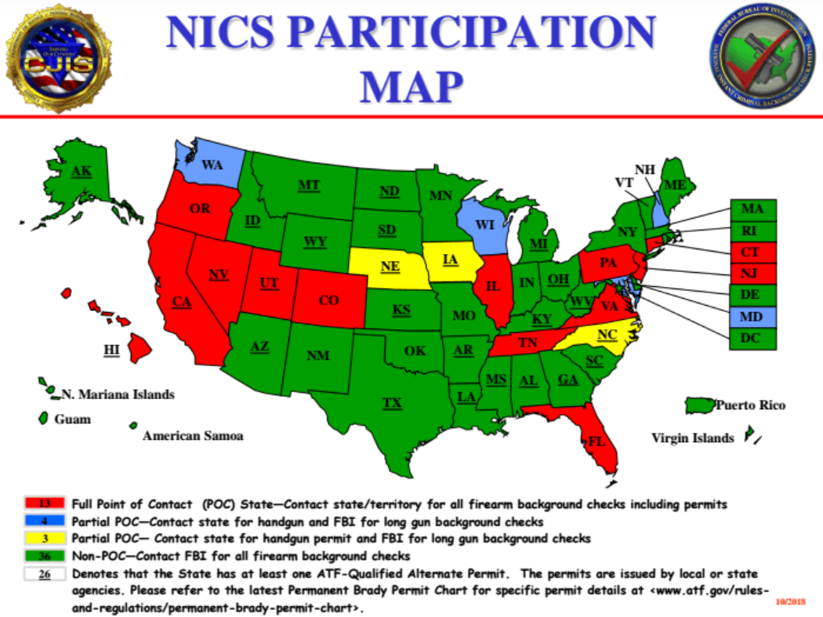
The National Instant Criminal Background Check System (NICS) is a United States system for determining if prospective firearms or explosives buyers' name and birth year match those of a person who is not eligible to buy. It was mandated by the Brady Handgun Violence Prevention Act (Brady Law) of 1993 and launched by the Federal Bureau of Investigation (FBI) in 1998.

Slide 3
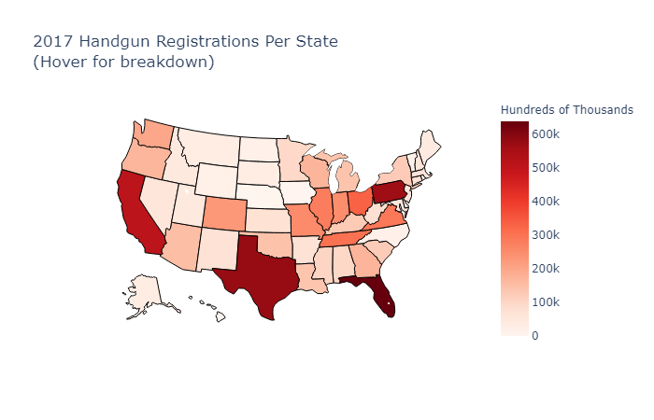
Handgun Registration Per State 2017

Slide 4
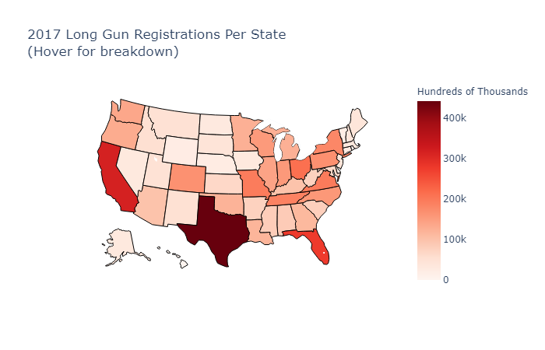
Long gun Registration Per State 2017

Slide 5
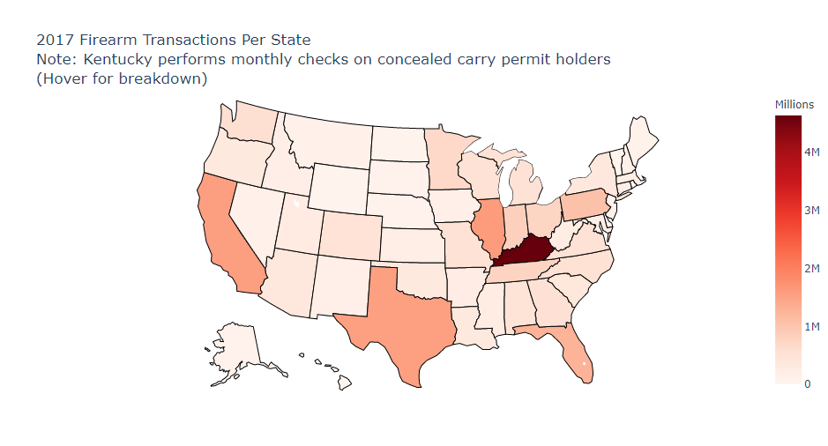
Firearm Transactions Per State 2017

Slide 6
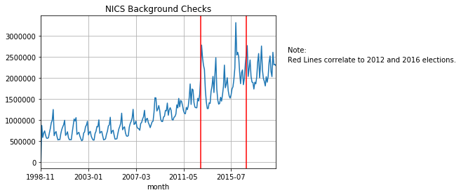
Complete history of background checks in the USA

Slide 7
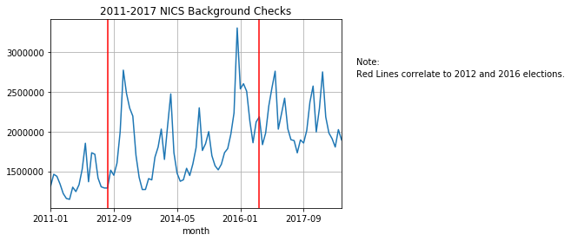
NICS Background Checks 2011-2017

Slide 8
Prohibited persons A prohibited person is one who: Has been convicted in any court of a crime punishable by imprisonment for a term exceeding one year; Is under indictment for a crime punishable by imprisonment for a term exceeding one year; Is a fugitive from justice; Is an unlawful user of or addicted to any controlled substance; Has been adjudicated as a mental defective or committed to a mental institution; Is illegally or unlawfully in the United States; Has been discharged from the Armed Forces under dishonorable conditions; Having been a citizen of the United States, has renounced U.S. citizenship; Is subject to a court order that restrains the person from harassing, stalking, or threatening an intimate partner or child of such intimate partner; Has been convicted in any court of a "misdemeanor crime of domestic violence", a defined term in 18 U.S.C. 921(a)(33)^{[21]}

Slide 9
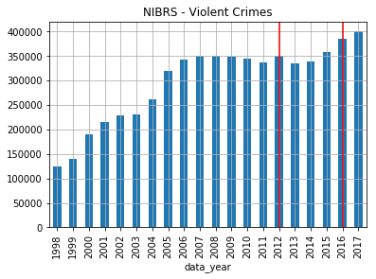
Plot the National Incident Based Reporting System (NIBRS) - Violent Crimes Data
Red lines correlate to 2012 and 2016 Presidential Election

Slide 10
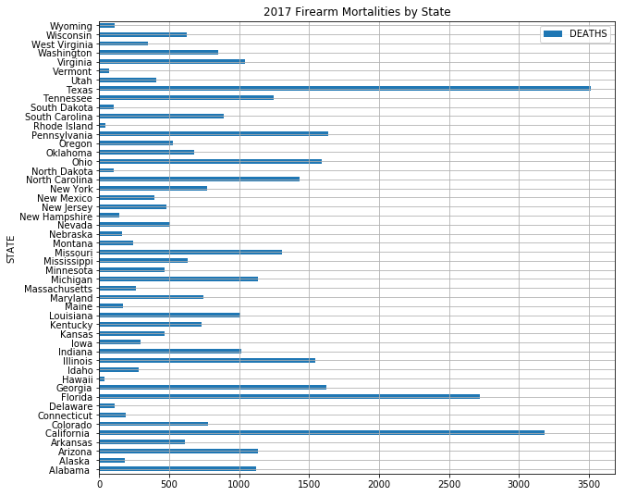
Firearm Mortalities by State 2017

Slide 11
Facts
Percentage of homes with firearms has fluctuated between 37-45% since 2000(Statista).
Approximately 30 million participating in firearms target shoots in 2017(Statista).
The US currently has the most gun-related murders per 100,000 people in the developed world, at a little over 3 gun murders per 100,000 people (CDC, 2015).
10,982 murders by various firearms in 2017, at least 7,032 by handguns (Statista).
In 2015, 2,824 children (age 0 to 19 years) died by gunshot and an additional 13,723 were injured (injury.research.chop.edu).
Approximately one of three handguns guns is kept loaded and unlocked and most children know where their parents keep their guns (injury.research.chop.edu).

Slide 12
References:
CDC (2015). Injury mortality reports 1999 and onwards (USA). In Web-based Injury Statistics Query and Reporting System / CDC WISQARS. Atlanta: National Center for Injury Prevention and Control, Centers for Disease Control and Prevention / CDC.
Percentage of households in the United States owning one or more firearms from 1972 to 2018
Number of participants in target shooting in the United States from 2006 to 2017 (in millions)*
Number of murder victims in the United States in 2017, by weapon
Gun Violence: Facts and Statistics
NICS & NIBRS, www.fbi.gov

